Slide 1
Video URL
https://queensuca-my.sharepoint.com/:v:/g/personal/18rjb10_queensu_ca/EXVbMC9DQ65CrBLlvqQbL80BYBTFiLazECDglQJi_eRttQ?e=CXNowD

Slide 2


Artemis
CISC-322 Group 14
Adrian Chu* | 18anhc@queensu.ca
Alex Baldassare | 18cab16@queensu.ca
Randy Bornstein* | 18rjb10@queensu.ca
Jake Halay** | 15jmh9@queensu.ca
Kashish Khandelwal | 20kmk3@queensu.ca
*Presenters **Group Leader
Notes:
Adrian

Slide 3
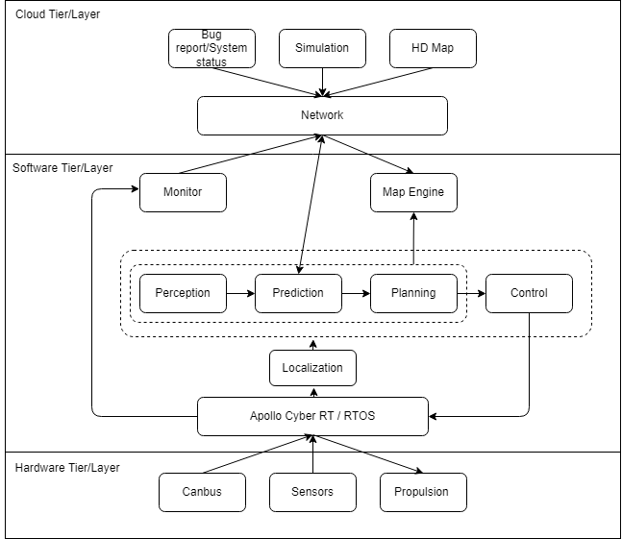
Conceptual Architecture
Notes:
Randy

Slide 4

Derivation process
Initial adversities
Provided readings and Apollo GitHub
THE FOLDER MONSTER!!!!!!!!
Important “module” folders & architecture representations
Conceptual component diagram draft
Style decision
Client-server, Layer, and Pipe-and-filter
Non-Functional Requirements
Tweaking the components diagram
Notes:
Randy

Slide 5
Non-Functional Requirements
Reliability
Availability
Portability
Scalability
Performance
Modifiability
Security
Notes:
Adrian
Here are some NFRs that we discovered from the architecture and how each architecture would generate benefits and drawbacks from them.

Slide 6
Architecture styles
Layered style
Client-server style
Pipe & Filter style
Notes:
Randy

Slide 7
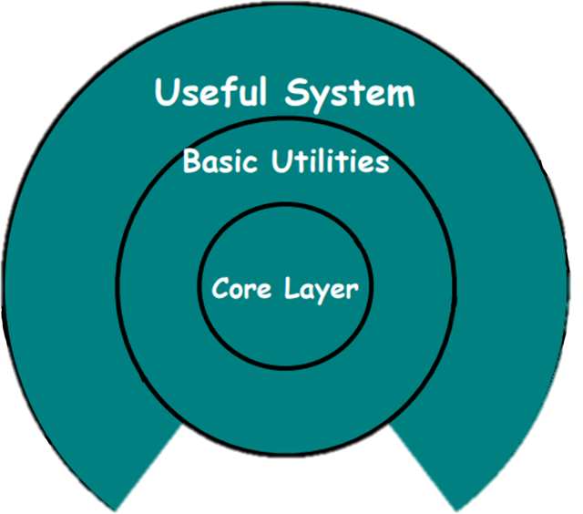
Layered style
Network & Apollo Cyber RT
Cloud Tier
Software Tier
Hardware Tier
Benefits
Easy distinction
Reusability
Chain improvements
Notes:
Randy

Slide 8
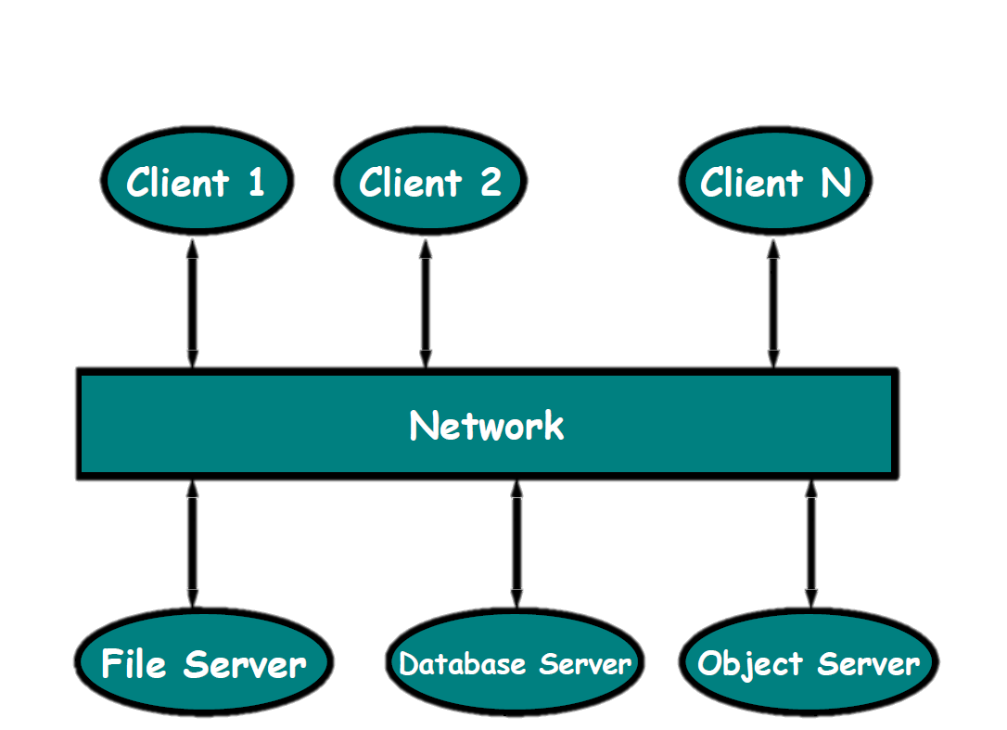
Client-server style
Cloud → Software tier
Distributing data across components
Benefits
Reliability, scalability
Constraints
Performance, availability
Notes:
Adrian
- Found under Apollo’s layered architectural style, the cloud tier depicts a client-server style architecture. As the diagram for the conceptual architecture suggests, the cloud tier of components governs the interflow of data from software to hardware tiers as the cloud tier serves as a communication medium between the car’s software navigation subsystem and hardware monitoring subsystem.
- In this use case, components consist of the client, which is the car’s software, and the server, which is the Cloud Service Platform offered by the Apollo Open Platform. Both components are connected via the network.
- The benefits of this style can be seen satisfying the NFRs regarding the system.
- Starting with reliability, the hardware components are evaluated concurrently as the Cloud Service Platform refreshes its system status. In case of a bug or hardware failure, the issue is detected and reported through the network to the server.
- By also taking advantage of the scalability of the cloud server, maintenance and updates can be done with little to no cost.
- However, liabilities have also been found. Mainly, the issues are dependent of network performance as the client components communicate with the server. Peaks and influxes may also pose a challenge when more clients are simulating or downloading map updates. Hence, limited reception and delays may question the availability of the system, (whether if it is always up and running or experiences chokes)
- Nevertheless, considering that if the map engine only requests for simulation and is updated periodically, the concurrent process of interacting with server-side and client-side components can be maintained

Slide 9
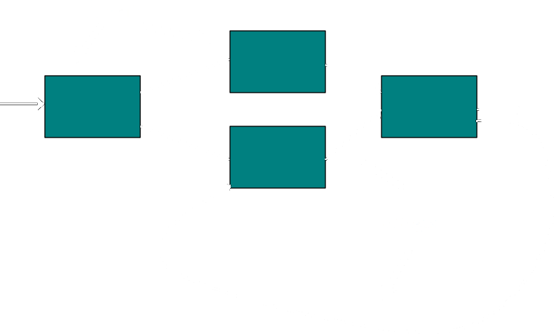
Pipe & Filter style
Major Components
Perception
Prediction
Planning
Control
Localization
Benefits
Reusability
Ease of maintainability
Notes:
Adrian
- From the open documentation of all versions of the Apollo software, an underlying and evident pipe-and-filter architecture has also been observed.
-This architecture encases numerous components, but it can be boiled down to 4 major components: Perception, Prediction, Planning, and Control. These components determine how the automated car's input devices react with the surroundings and allow the Real time operating system to process information.
- Hence, such an architecture allows the enormous flow of data from one segment to another through “pipes” to initiate courses of actions.
- Going with this architecture style also brings benefits from the four components:
Perception: It helps in identifying different perception tasks such as classification, detection, segmentation, and learning convolutional neural networks.
Prediction: It helps the system to study different ways to predict how other vehicles or pedestrians might move in front of the car.
Planning: It helps in identifying several different approaches which Apollo uses to develop trajectories for autonomous vehicles.
Control: As the name suggests, it assists the RTOS for steering the car, throttle responses, and brakes to execute the planned trajectory.
- To maintain the system, the localization subcomponent also plays a vital role. The general responsibility of this component is to provide information to the aforementioned components about the vehicles' physical location. Using a paired combination of realtime kinematic based method and inertial measurement, as well as utilizing LiDAR measurements, these methods allow the system to pinpoint the location.
- Overall, this systems takes advantage of reusability and ease of maintainability as the system can be made to be more precise, responsive, and updated computationally, which is something the architecture style is known for its ability to make enhancements to the existing system.

Slide 10
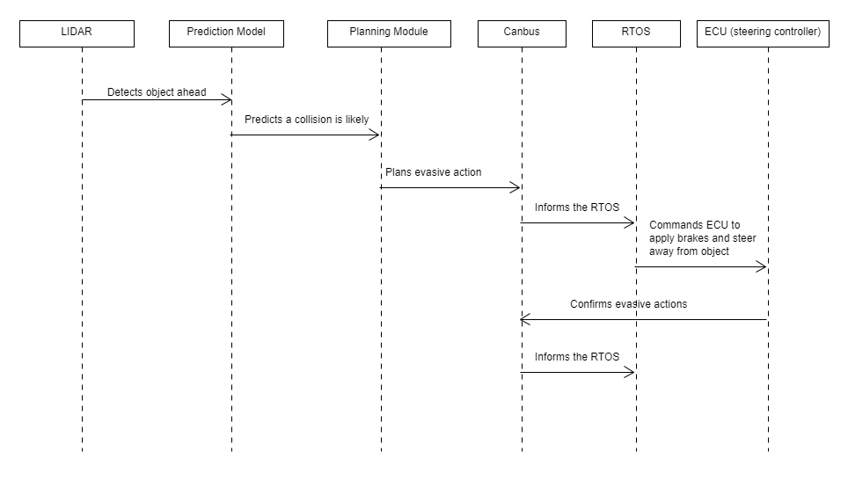
Use cases
1. Obstacles ahead and emergency braking
Notes:
Randy

Slide 11
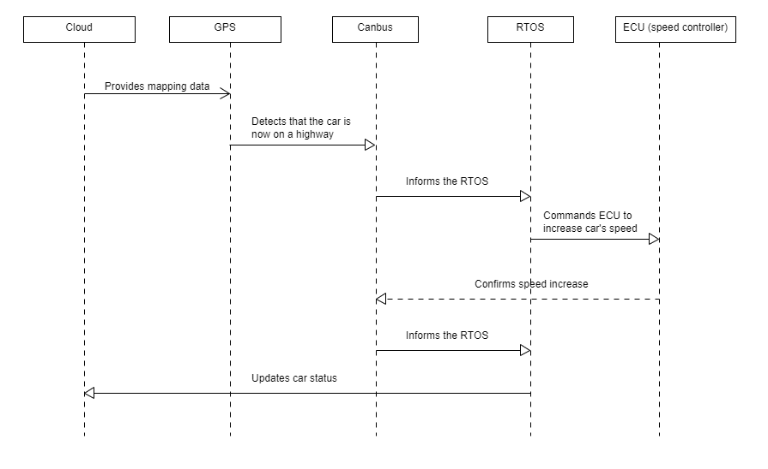
Use cases
2. Speed control on a highway
Notes:
Randy

Slide 12
Lessons learned
Expand attention to the functionality of other systems
Referencing architectures
Considering for different stakeholders with who bear different objectives
Synthesize abstract information
Notes:
Adrian
1. Tackle the issue of scarce information found on the documentation, we had to expand our attention to the functionality of other autonomous driving systems and understand Apollo’s inner structure by referencing other systems. It is important to note that many autonomous systems share similar modules and components and hence, the scope of our investigation was enlarged.
2. We also discovered that not all stakeholders would be able to understand the functionality of the system, not to mention the inner subsystems and how the components would aid the user. It was crucial that the conceptual architecture documented was straightforward and understandable by all stakeholders, including users and marketers alike.
3. By synthesizing the abstract information, it allowed us to identify and elaborate on how each of the proposed architectures would benefit the system as well as the stakeholders’ requirements.

Slide 13

-Thank you-

